Slide 1

Ruby on Rails

Slide 2
About today…
Ruby on Rails
Controllers
Routes

Slide 3
Adjust Routes & Controller in Rails

Slide 4
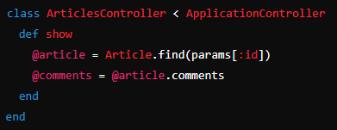
Updating the Articles Controller
Articles Controller (app/controllers/articles_controller.rb)
def show action
Fetches the article based on the id parameter
Retrieves all comments associated with the article

Slide 5
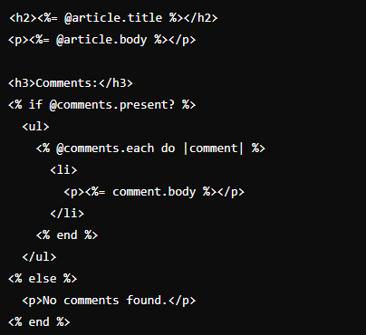
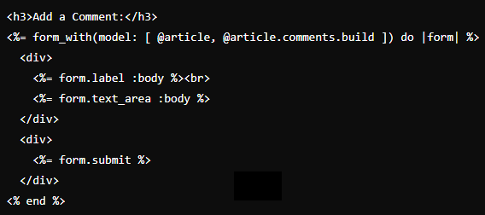
Updating the Views
Article Show View (app/views/articles/show.html.erb):
Displaying Article and Comments
Shows the article's title and body
Iterates over @comments to display each comment
Comment Form
Provides a form to add new comments to the article

Slide 6
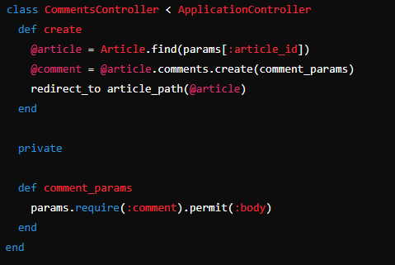
Adding Comments Controller
Comments Controller (app/controllers/comments_controller.rb)
def create action
Finds the article based on article_id
Creates a new comment associated with the article
Redirects to the article's show page
Strong Parameters
Ensures only permitted parameters (body) are accepted for creating a comment

Slide 7
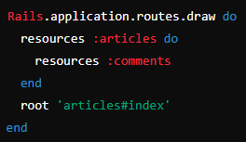
Routes for Comments
Routes Configuration (config/routes.rb)

Slide 8
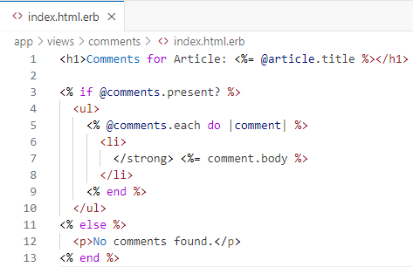
Creating Comments Views
Article Show View (app/views/comments/index.html.erb):

Slide 9
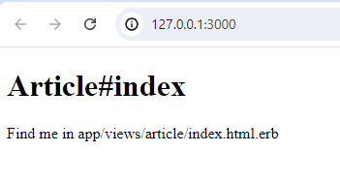
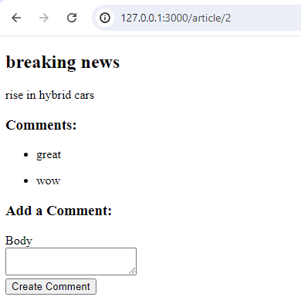
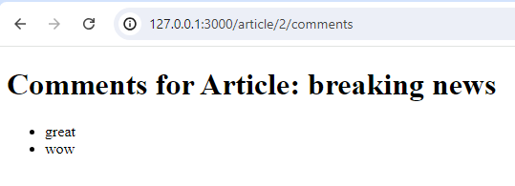
Examine routes

Slide 10


Slide 11

Task 1
Create a RoR app and apply routing mechanism

